Slide 1

CanberraUAV Workshop
Feb 2017

Slide 2
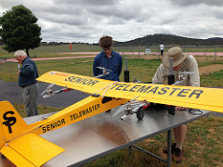
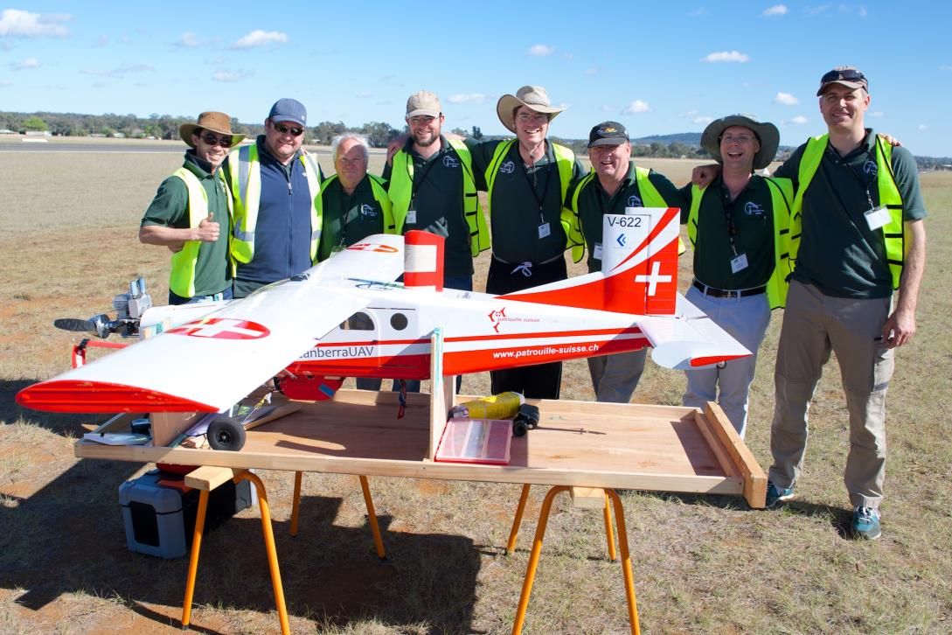
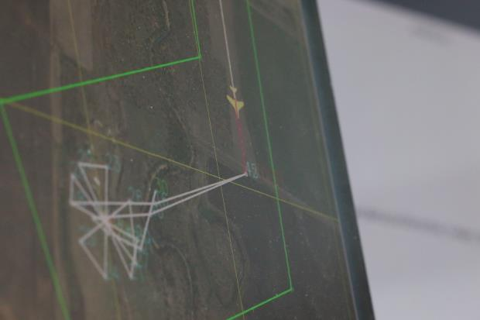
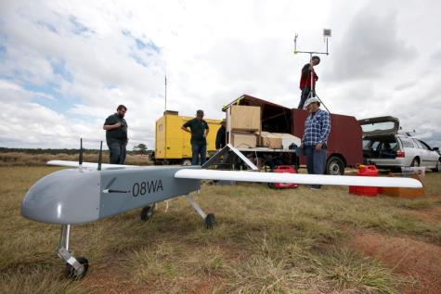
About CanberraUAV

Slide 3
About CanberraUAV
Community association
R&D on UAV’s
Education
Regularly meet up
Sunday mornings at CMAC
Monday evening teleconference
Most discussions take place on the mailing list or at our meetups

